Slide 1
Blockchain based Mobile Edge Computing
Reporter: Dongdong Yue

Slide 2
Survey on related work
Chenhan Xu, Kun Wang, Guoliang Xu, Peng Li, Song Guo, Jiangtao Luo. “ Making Big Data Open in Collaborative Edges: A Blockchain-Based Framework with Reduced Resource Requirements ”. IEEE International Conference on Communications (ICC) 2018
Yiming Liu, F. Richard Yu, Xi Li, Hong Ji, Victor C. M. Leung. “ Resource Allocation for Video Transcoding and Delivery Based on Mobile Edge Computing and Blockchain ”. IEEE Global Communications Conference (GLOBECOM) 2018
Chengpeng Xia, Hui Chen, Xuelian Liu, Jigang Wu, Long Chen. “ETRA: Efficient Three-Stage Resource Allocation Auction for Mobile Blockchain in Edge Computing” IEEE International Conference on Parallel and Distributed Systems (ICPADS) 2018
Xuelian Liu, Jigang Wu, Long Chen, Chengpeng Xia. “Efficient Auction Mechanism for Edge Computing Resource Allocation in Mobile Blockchain”. IEEE International Conference on High Performance Computing and Communications (HPCC) 2019
Notes:
Firstly, I will briefly introduce these relevant works, and then I will introduce my own work in this field.
Since the work of the third and fourth paper are similar, I will only introduce the fourth paper.
关于blockchain combined with edge computing的文章：
5篇ICC，基本都是关于edge computing中的资源的分配/管理的问题；
2篇SEC (IFIP International Information Security Conference)，关于移动支付和征信问题；
2篇HPCC，关于区块链的计算资源如何卸载到边缘服务器上面，即边缘服务器的资源分配问题；

Slide 3
Making Big Data Open in Collaborative Edges: A Blockchain-Based Framework with Reduced Resource Requirements
Background
Edge computing emerges, since it may effectively decrease time latency via deploying services at the edge of network, such as mobile phones, surveillance cameras, and Internet of things (IoT) sensors.
Issues
These edge devices may not always cooperate (eg. share data) with each other because they are in a distrusted environment.
Edge devices have limited storage resources, which is hardened to store the whole ledger of blockchain.
Notes:
The first paper I am going to report is Making big data open…….

Slide 4
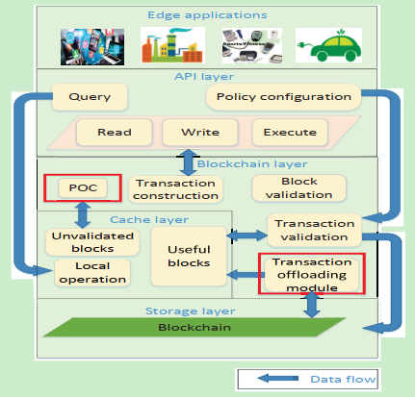
Solution – four layers framework
API layer offers interface services for edge applications.
Blockchain layer implements the content of blockchain in edges.
Storage layer provides persistent storage.
Fig. 1. Green blockchain framework in collaborative edges.
Notes:
To solve these issues, they proposed a four layers framework shows in figure one.
API layer and blockchain layer can directly access data from cache layer, rather than from storage layer, which reduces the response time and makes system adapted for big data sharing.
The contents of the red box ,POC is used to solve the problem of distrusted problem between edge devices, and transaction offloading module is used to solve the problem of limited storage resource of each edge devices.

Slide 5
Proof-of-Collaboration (POC)
Collaboration Credit represent fee, each transaction need to pay fee, which resolve the untrusted issues.
Transaction offloading module
The blocks that carry useful transactions will be updated to the cache layer.
The blocks only carry useless transactions will be sent to stakeholders’ clouds for backup. Then, these blocks will be dropped from edge devices, which resolve the problem of limited resource of edge devices.
Useless transaction: The transaction whose outputs are all referenced by the latter transactions is useless for the validation of the new generated transaction .

Slide 6
Resource Allocation for Video Transcoding and Delivery Based on Mobile Edge Computing and Blockchain
Background
Obtaining video contents from the proximate small base station (SBSs) instead of a remote content provider (CPs), users can enjoy low-latency services.
Issues
Due to the heterogeneous devices and dynamic network conditions, the video streams usually have to be transformed into different bitrate versions to adapt to diverse mobile devices. However, video transcoding is a time-consuming task and requires scalable computational resources. ( limited computing resources )
How to enable a secure, feasible and decentralized video streaming services among the untrusted CPs, SBSs, and users?
Notes:
The second paper I am going to report is …….
Since video transcoding is a time-consuming task and requires scalable computational resources, this is a challenge on mobile edge computing.

Slide 7
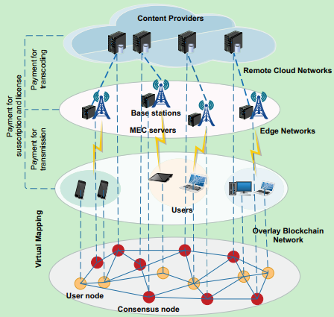
Solution
Cloud network store original video, edge network store transcoded video.
Each entity (e.g CP, SBS, user) maps itself as a node in the blockchain network.
CP and SBSs work as the consensus nodes to participate in the consensus process.
Users work as user nodes and only send requests for content delivery.
Smart contracts ensures the correct execution of the content trading.
Fig. 2. Blockchain-based MEC Network Architecture.
Notes:
To solve these issues, this paper proposed a blockchain-based MEC network architecture shows in figure two.

Slide 8
Efficient Auction Mechanism for Edge Computing Resource Allocation in Mobile Blockchain
Background
Mobile devices cannot afford computing resources required by the mining processes in mobile blockchain.
Issues
How to offload mining tasks to edge servers which can provide computing resources for the mobile devices by selling their virtual machine (VM) instances?
How to allocate and price these VM instances?
Notes:
The third paper I am going to report is …….
This paper consider offloading mining tasks to edge servers which can provide computing resources for the mobile devices by selling their virtual machine (VM) instances.
So, the main problem that this paper aimed to resolve is how to allocate and price these VM instances.
They formulate this problem as a resource allocation problem.

Slide 9
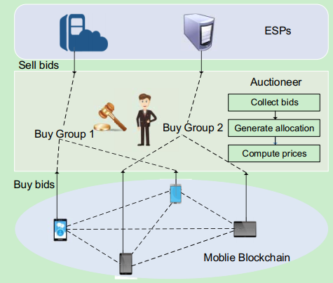
Solution
An auction-based allocation mechanism is proposed for edge computing resource allocation.
Miners and ESPs submit bids to a central auctioneer for buying or selling VM instances.
As the seller, the ESPs are permitted to provide group buying rule.
The allocation algorithm is proposed to solve the resource allocation problem.
Fig. 3. System model.
Notes:
Figure 3 shows the system model of their solution.
Group buying can offer goods or services at a discount price when the quantity of buyers achieve some target number. When the auction is over, miners can use the resources they buy to mine.

Slide 10
Summary of issues under edge computing
Limited storage & computing resource
Untrusted among edge devices
Resource allocation problem
Notes:
In fact, the third problem arises from the first problem.
Limited storage & computing resource （资源分配，资源卸载的方法）
Untrusted among edge devices (区块链的共识机制去解决)
Resource allocation problem (拍卖机制来解决)
关于blockchain combined with edge computing的文章：
5篇ICC，基本都是关于edge computing中的资源的分配/管理的问题；
2篇SEC (IFIP International Information Security Conference)，关于移动支付和征信问题；
2篇HPCC，关于区块链的计算资源如何卸载到边缘服务器上面，即边缘服务器的资源分配问题；

Slide 11
Background of my previous work
Problems
1. TPA is not entirely credible.
2. Cloud storage is centralized.
Fig. 4. Data storage and integrity verification on the cloud under traditional architecture.
Notes:
Next, I will introduce my own work. My previous work mainly solved the problem of data integrity verification in cloud storage.
Figure four shows the traditional data integrity verification mechanism. There are there entities in this model, client, cloud storage servers and third party auditor.
Client can upload and download data from the Cloud Storage Servers. Third party auditor is introduced for data integrity verification. When client and cloud storage servers provide some useful information to the Third Party Auditor, the Third Party Auditor can verify the data integrity and return the result to client and cloud storage servers.
There are two drawbacks on this verification mechanism:
1. TPA is composed of one or several organizations, which is centralized in a sense. So, it might have single point of failure and untrusted problem.
2. This verification mechanisms are only suitable for centralized cloud storage servers. But with the development of cloud storage, distributed cloud storage has emerged.
Therefore, this verification mechanism is no longer applicable.

Slide 12
Blockchain Based Data Integrity Verification in P2P Cloud Storage
Fig. 5. The workflow of client uploading data to P2P cloud storage servers.
Fig. 6. The workflow of verifying data integrity in P2P cloud storage servers combined with blockchain.
Notes:
To solve these above two issues, I proposed a two-stage verification framework.
Fig.5. shows the first stage. In this stage, client can do some preparation work for later data integrity verification, and then uploading data to the cloud.
Fig.6. shows the second stage. In this stage, data integrity verification can be done combined with blockchain.

Slide 13
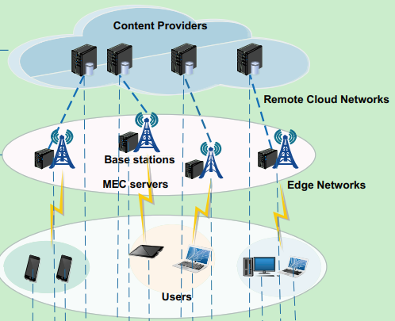
New system model under edge computing
Since it may effectively decrease time latency via deploying services at the edge of network. The centralized cloud-assisted Internet of Things (CoT) model is changing to the decentralized edge computing model.
Fig. 7. Decentralized edge computing model of Internet of Things.
Notes:
Users only need to contact with edge networks to get content services.

Slide 14
Differences between two models
Different participants in data integrity verification
Previous: users and cloud
New model: users, cloud and edge nodes
Different resource constraints
Previous:
Cloud do not have storage and computing resource limitation.
New model:
The performance of the cloud remains the same.
Edge nodes have limited storage and computing resources.

Slide 15
Two issues under edge computing
How to solve the problem of limited storage resources on edge nodes so that edge nodes can participate in the work of data integrity verification？
How to solve the problem of limited computing resources of edge nodes so that edge nodes can participate in the verification and consensus of blockchain?

Slide 16
Solutions for above two issues
Dispersing storage data
The original data are stored in the cloud.
The information that used for data integrity verification are putted on the edge nodes. Since this information is much smaller than the original data, the storage problem of edge computing can be resolved.
Selective participation
Among all the edge nodes, we choose the node with relatively high storage and computing power (e.g. base station) to participate in the consensus of blockchain.
Notes:
1. The problem of limited storage resources in edge nodes is solved by dispersing storage data
2. Since the consensus process needs to verify the legality of the transaction, the nodes participating in the consensus need to store all the blockchain ledger.
Therefore, the consensus node needs certain storage capacity and computing capacity. So, we proposed selective participation.

Slide 17
Solutions for above two issues
Resource allocation (ongoing)
Each user, edge node, and cloud can participate in the maintenance of blockchain.
For those users and edge nodes who do not have enough resources, they can purchase resources from the cloud and then to participate in the maintenance of the blockchain.
Thus, resource allocation between cloud and user/edge node is involved, which can be solved by referring to the relative auction algorithm.
Notes:
So, my next work plan is to consider whether there is an effective resource allocation mechanism can be worked at our scenario.

Slide 18
Thanks!

